Slide 1

Clustering Analysis of Customer Behaviour
Report by Team 2

Slide 2
Objectives
Understanding Customer Behavior:
Analyze spending patterns of customers across different types of products and understand the level of engagement based on purchase recency and frequency.
Segment Customer Base:
Identify and group customers based on their demographics, their spending habits and their responsiveness to marketing tactics.
Enhance Marketing Strategies:
Develop personalized marketing campaigns tailored to specific customer segments after analysing their behaviour.

Slide 3
Features of the Data Set
People
ID: Customer's unique identifier
Year_Birth: Customer's birth year
Education: Customer's education level
Marital_Status: Customer's marital status
Income: Customer's yearly household income
Kidhome: Number of children in customer's household
Teenhome: Number of teenagers in customer's household
Dt_Customer: Date of customer's enrollment with the company
Recency: Number of days since customer's last purchase
Complain: 1 if the customer complained in the last 2 years, 0 otherwise
Products
MntWines: Amount spent on wine in last 2 years
MntFruits: Amount spent on fruits in last 2 years
MntMeatProducts: Amount spent on meat in last 2 years
MntFishProducts: Amount spent on fish in last 2 years
MntSweetProducts: Amount spent on sweets in last 2 years
MntGoldProds: Amount spent on gold in last 2 years
haviour
Promotion
NumDealsPurchases: Number of purchases made with a discount
AcceptedCmp1: 1 if customer accepted the offer in the 1st campaign, 0 otherwise
AcceptedCmp2: 1 if customer accepted the offer in the 2nd campaign, 0 otherwise
AcceptedCmp3: 1 if customer accepted the offer in the 3rd campaign, 0 otherwise
AcceptedCmp4: 1 if customer accepted the offer in the 4th campaign, 0 otherwise
AcceptedCmp5: 1 if customer accepted the offer in the 5th campaign, 0 otherwise
Response: 1 if customer accepted the offer in the last campaign, 0 otherwise
Place
NumWebPurchases: Number of purchases made through the company’s website
NumCatalogPurchases: Number of purchases made using a catalogue
NumStorePurchases: Number of purchases made directly in stores
NumWebVisitsMonth: Number of visits to company’s website in the last month

Slide 4
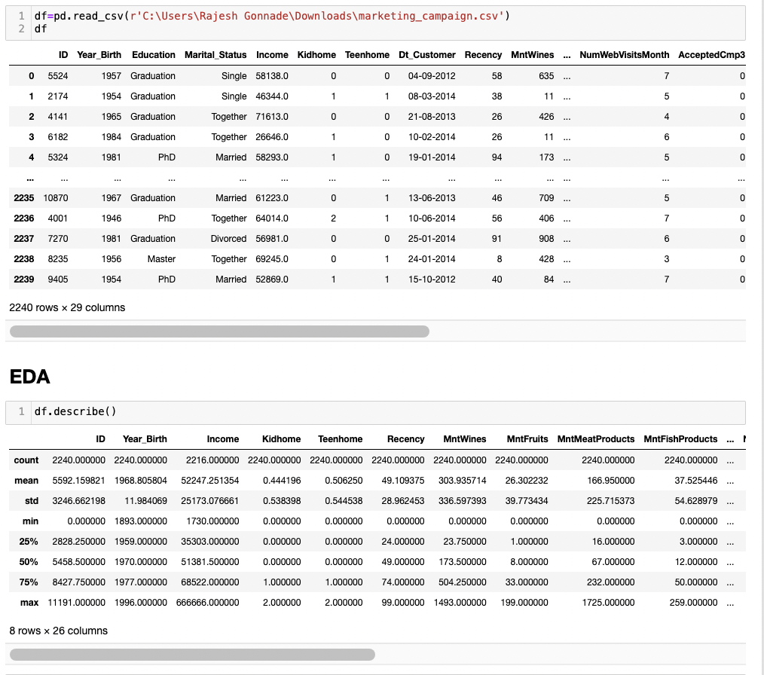
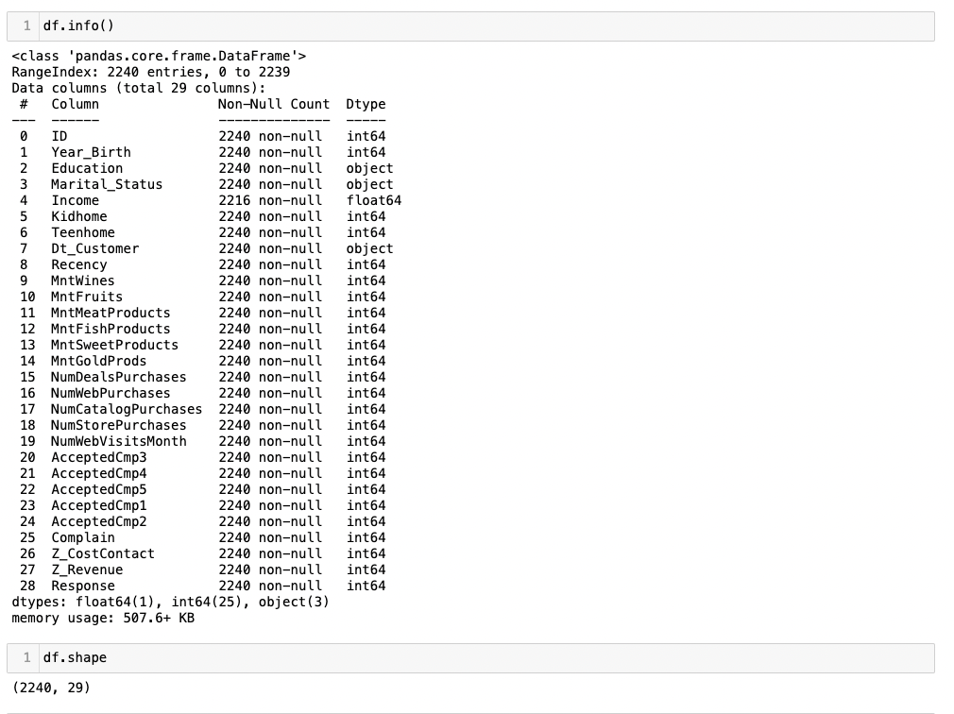
Understanding the data

Slide 5
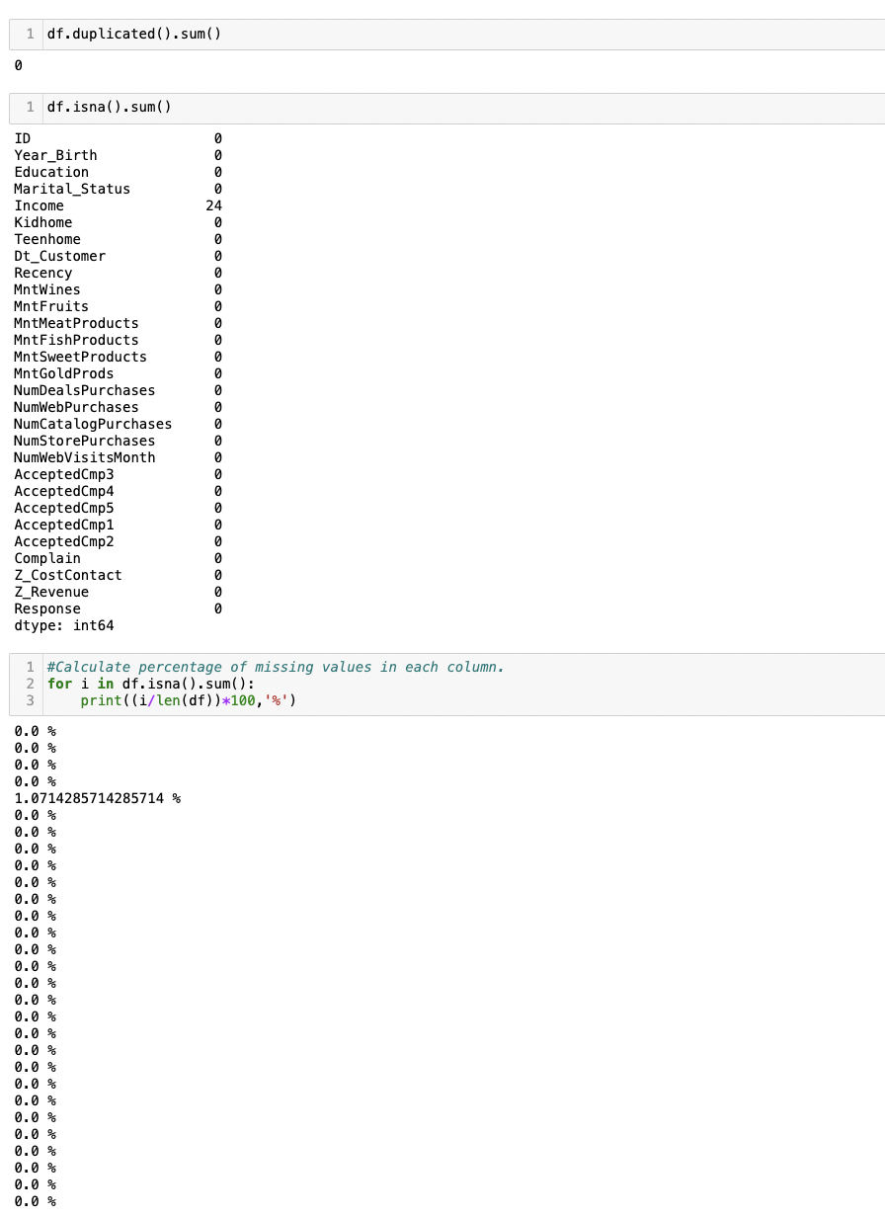
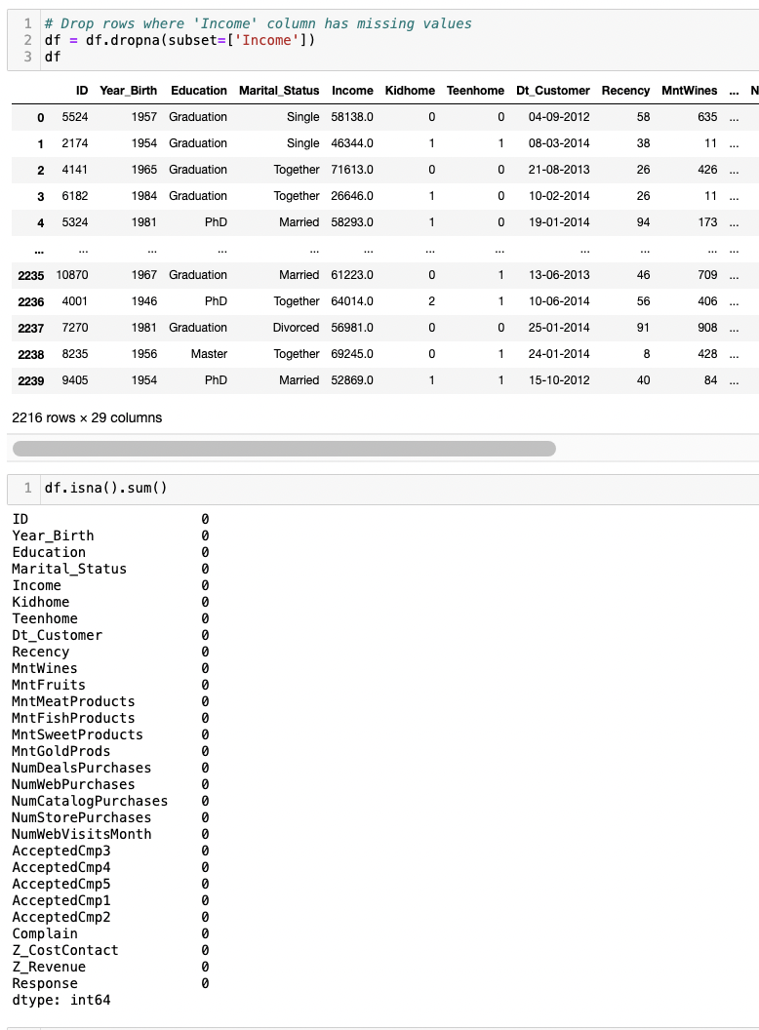
Cleaning the Data
- Removing gaps in the data

Slide 6
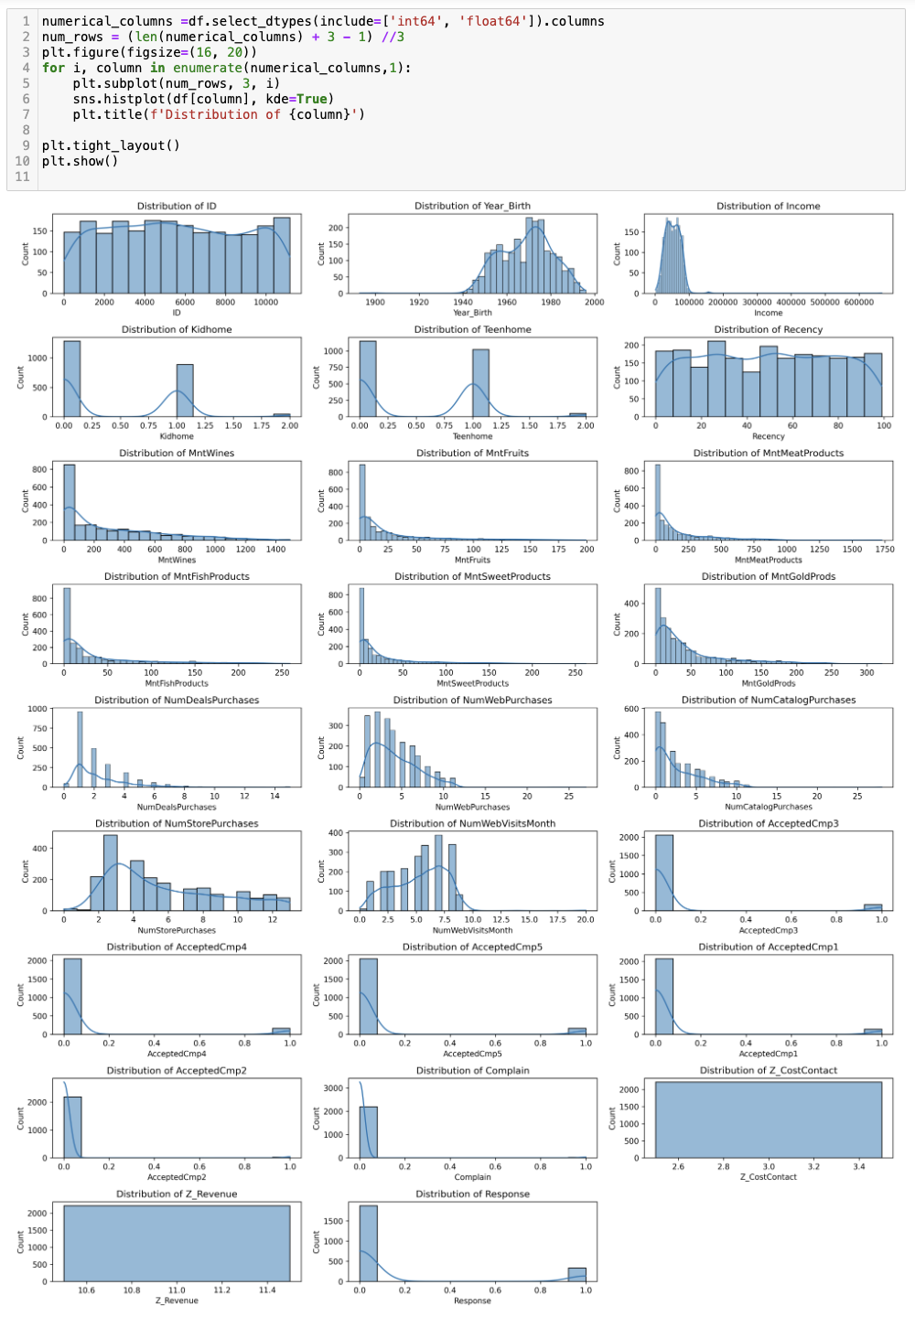
Visualizing the distribution of data in all columns to understand them better

Slide 7
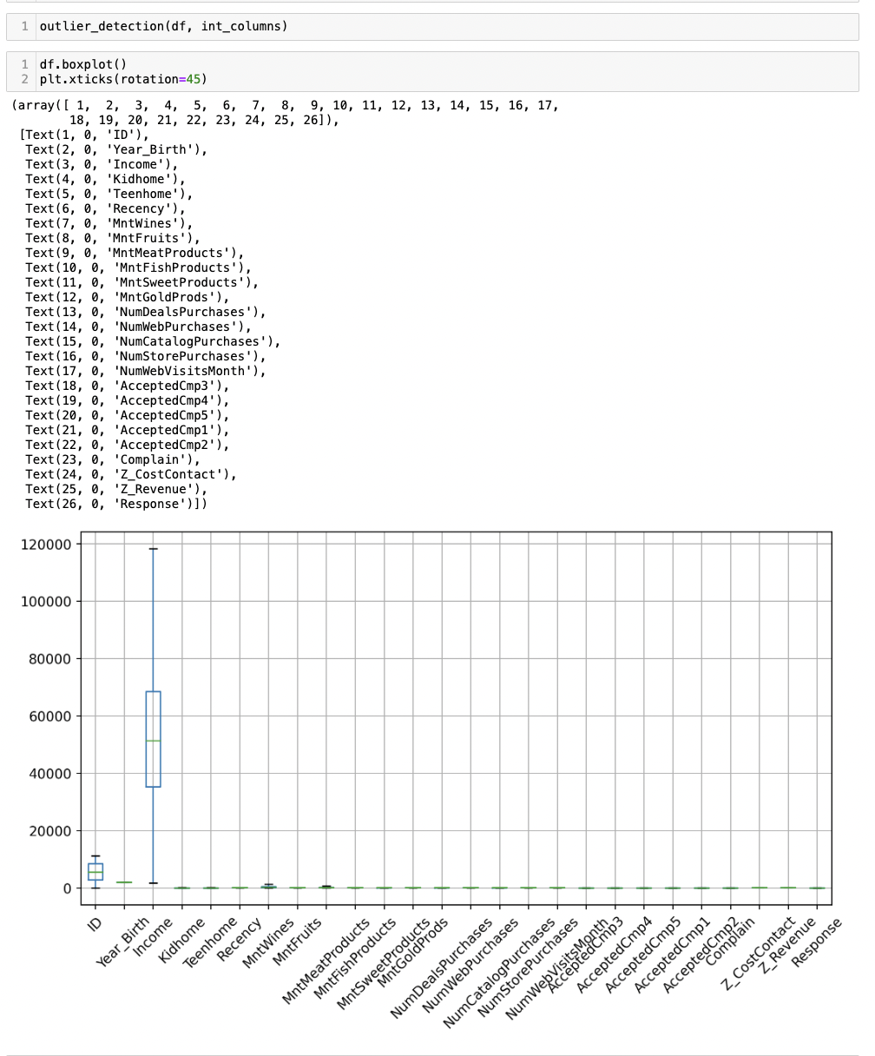
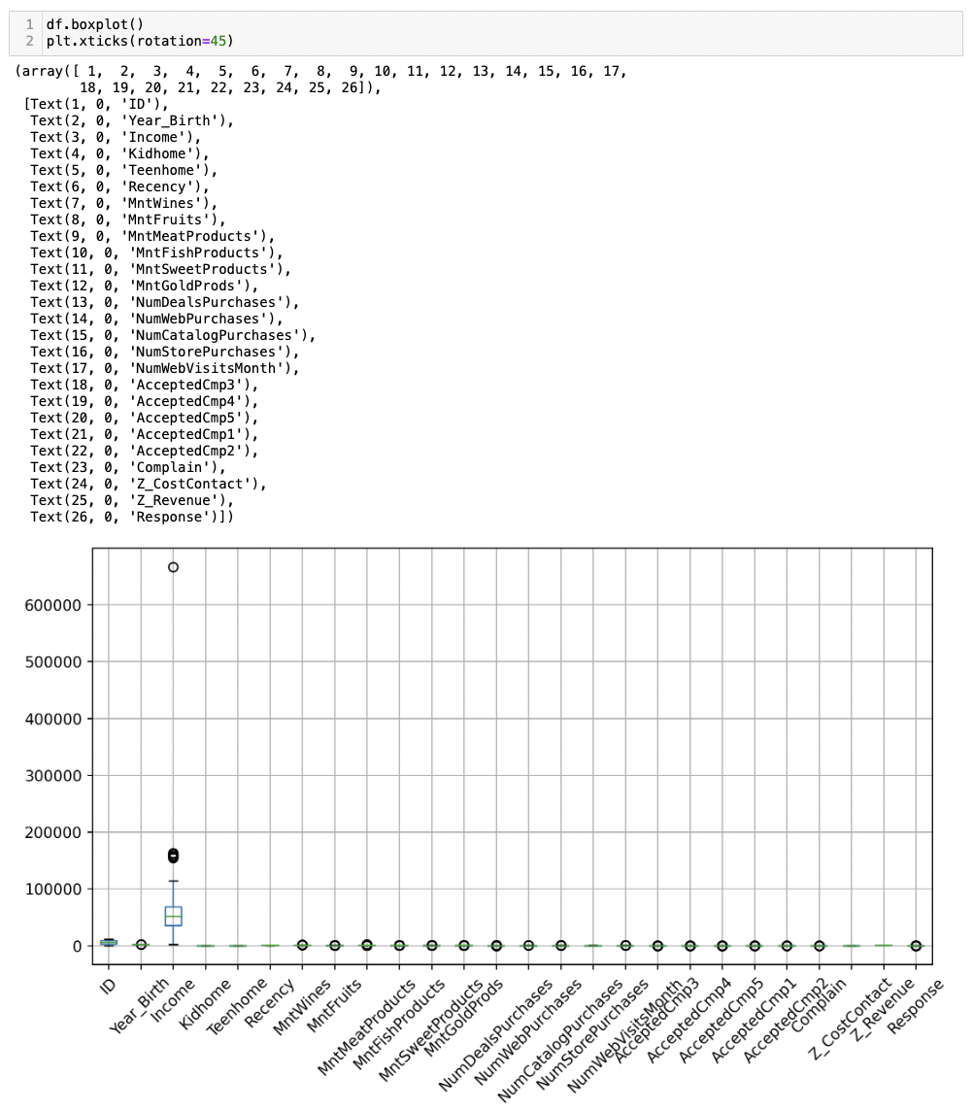
Detecting the outliers in the data with the help of boxplot

Slide 8
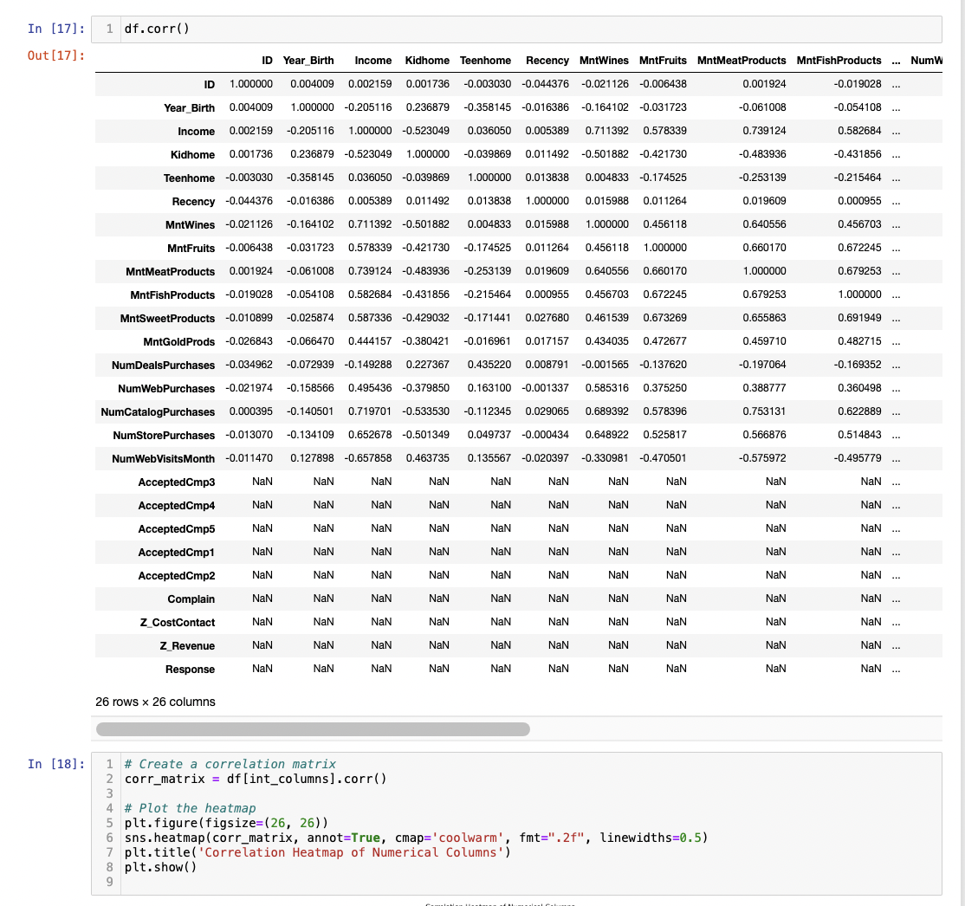
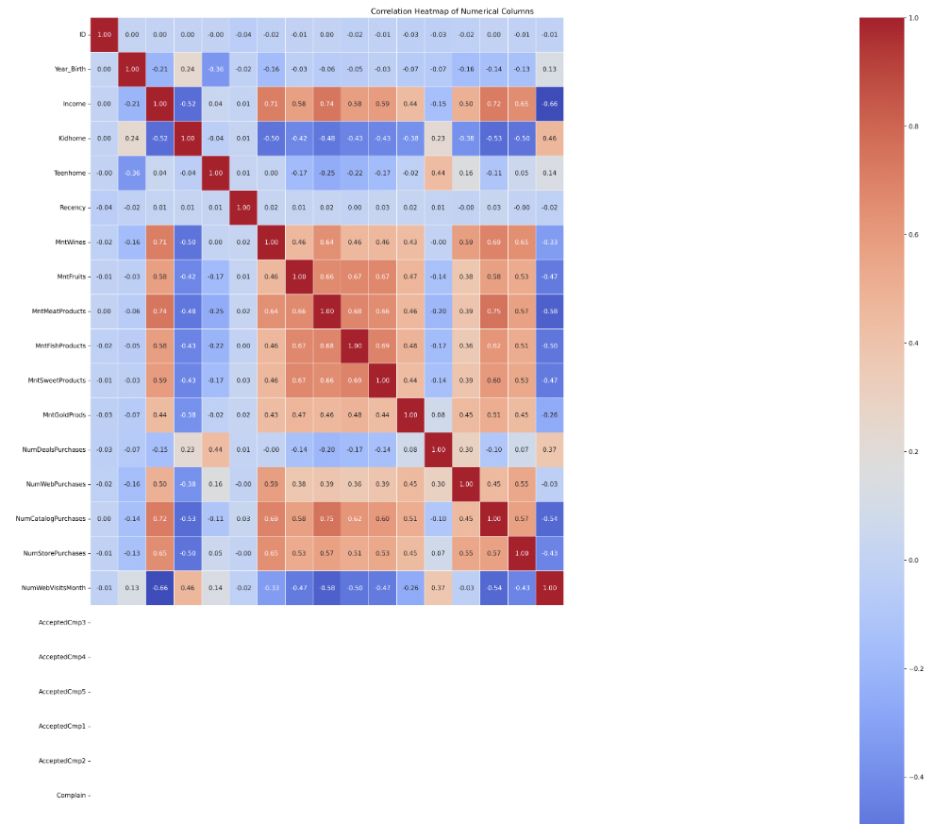
EDA
- Generating a correlation matrix

Slide 9
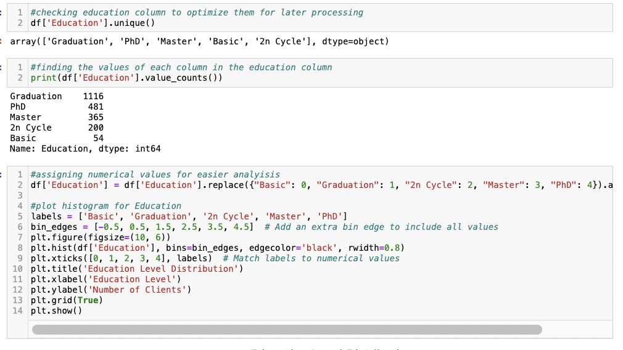
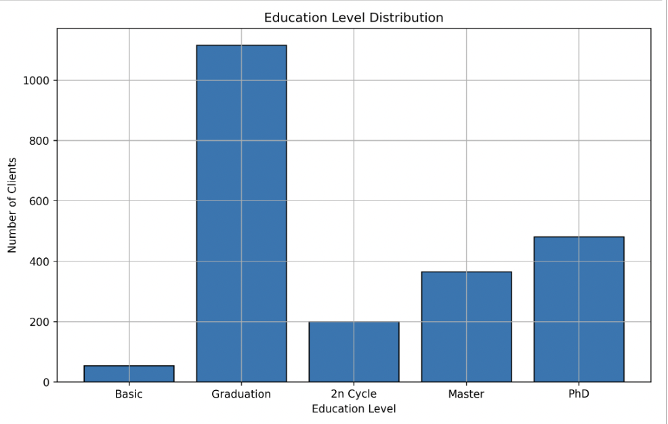
Preprocessing Education column for easier analysis
-assigning numerical values to the columns in education.
From this graph we can see that the biggest buyers are Graduates and the lowest buyers are Undergraduates. This makes sense as Graduates or higher have a higher buying power than Undergraduates due to the gap in their income.

Slide 10
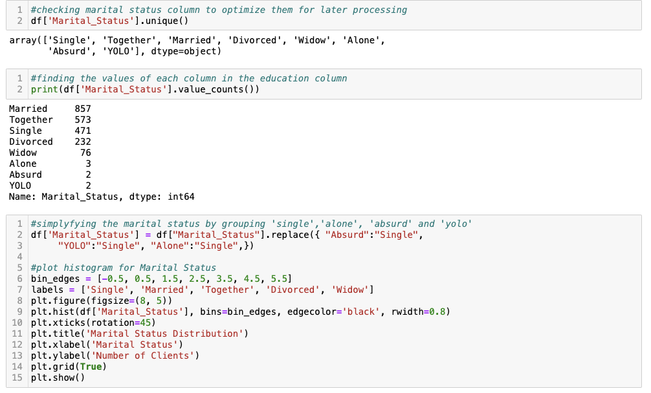
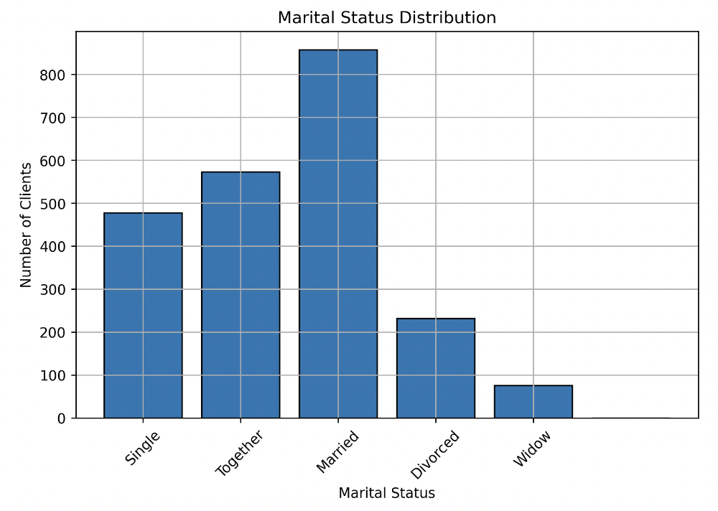
Preprocessing Marital Status for easier analysis
Grouping ‘alone’, ‘absurd’ and ‘yolo’ into ‘single’ as they have very negligible numbers otherwise and mean the same thing.

Slide 11
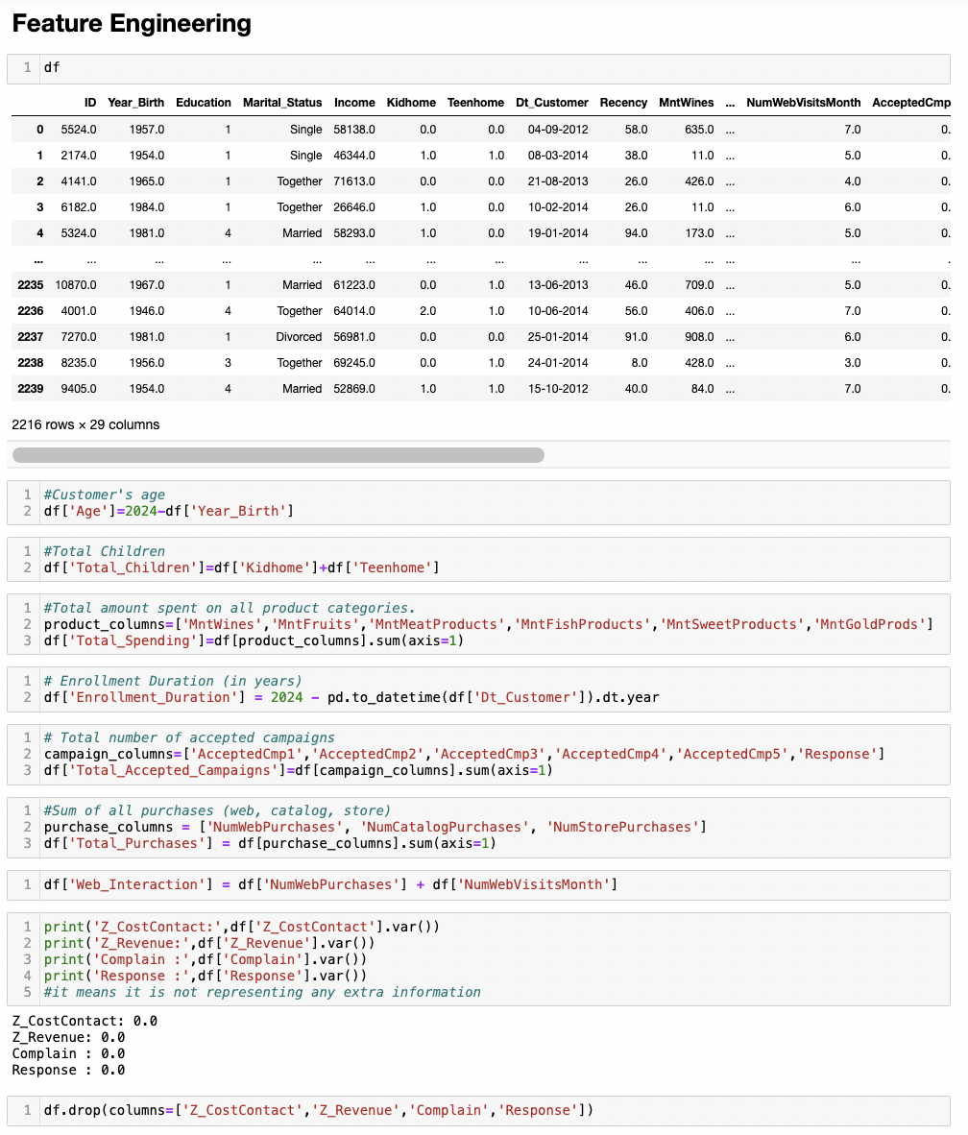
Feature Engineering
Creating columns for:-
Age – By subtracting the ‘Year_Birth’ from 2024
Total Children – By adding the values for ‘Kidhome’ and ‘Teenhome’
Total Spending– By adding 'MntWines’, 'MntFruits’, 'MntMeatProducts’, 'MntFishProducts’, 'MntSweetProducts’ and 'MntGoldProds’
Enrollment Duration – By subtracting ‘Dt_Customer’ from 2024
Total Purchases – By adding 'NumWebPurchases', 'NumCatalogPurchases’ and 'NumStorePurchases’
Total Accepted Campaigns – By adding 'AcceptedCmp1’, 'AcceptedCmp2’, 'AcceptedCmp3',’ AcceptedCmp4’, 'AcceptedCmp5’ and 'Response’
Web Interaction – By adding ‘NumWebPurchases’ and ‘NumWebVisitsMonth’
Removing
‘Z_CostContact’
‘Z-revenue’
‘Complain’,
‘Response’
after checking the variance and seeing that its 0. This means that these features do not represent any additional information.

Slide 12
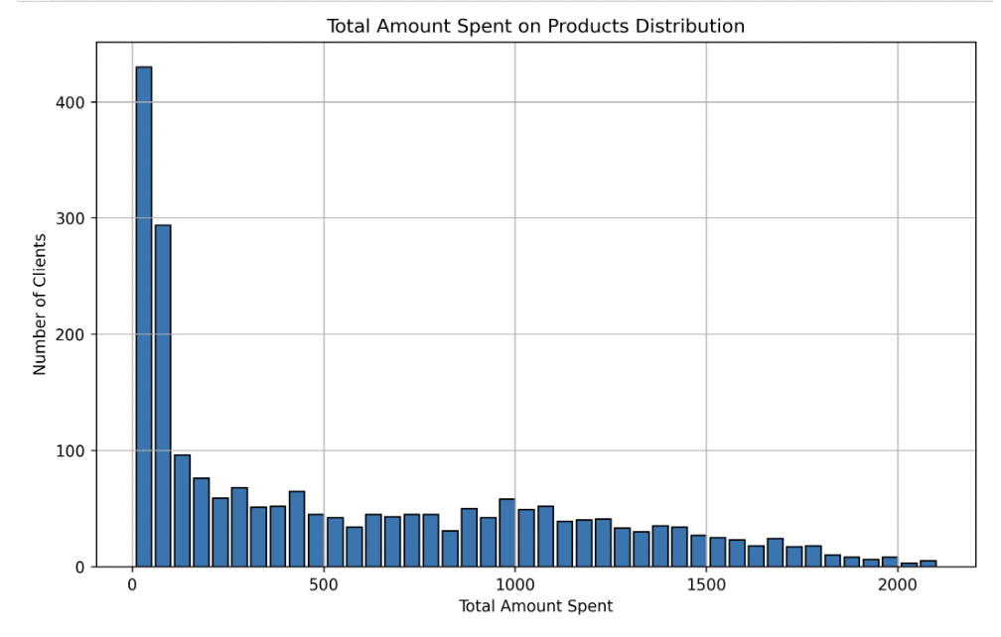
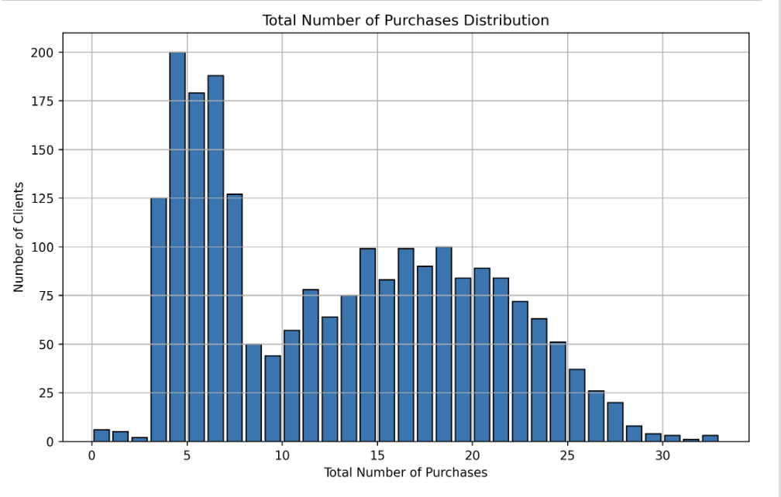
Visualizing generated column data with histograms to get a better understanding

Slide 13
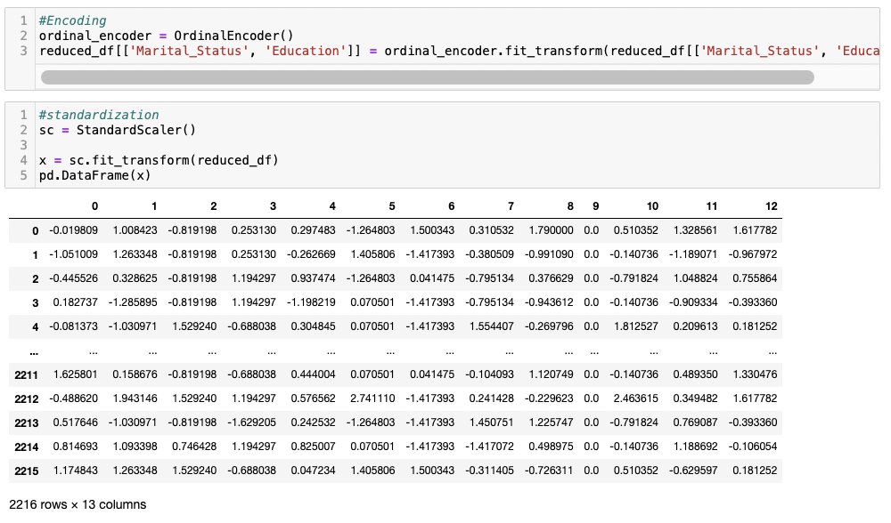
Data Scaling and Encoding

Slide 14
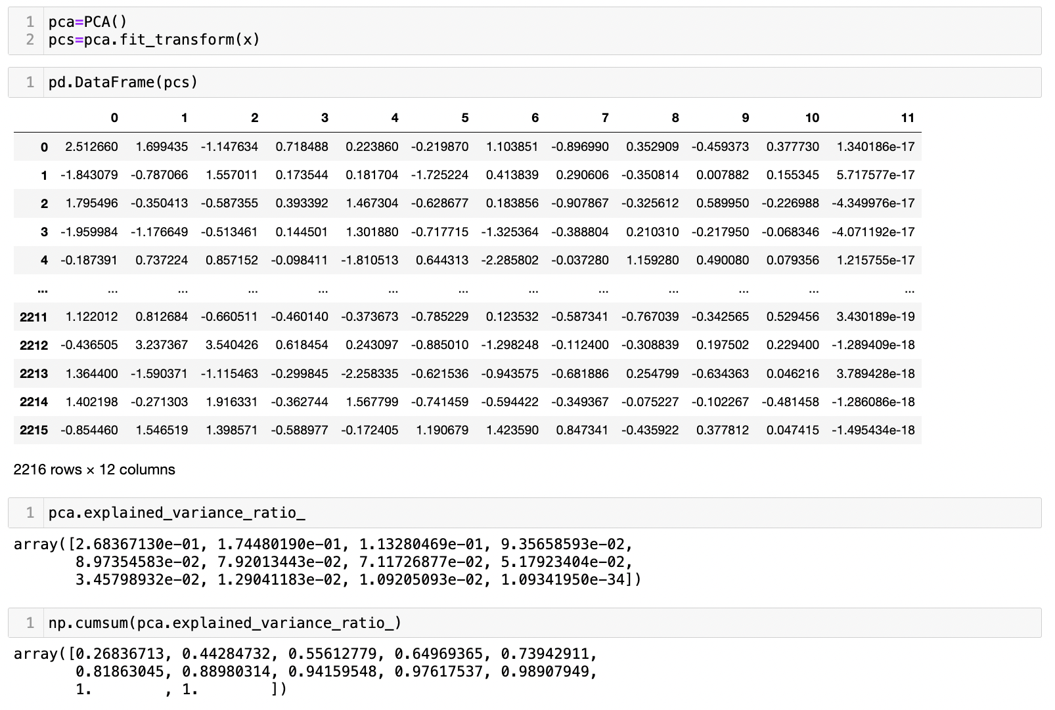
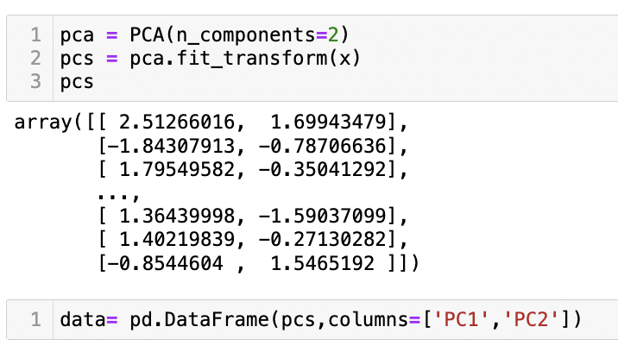
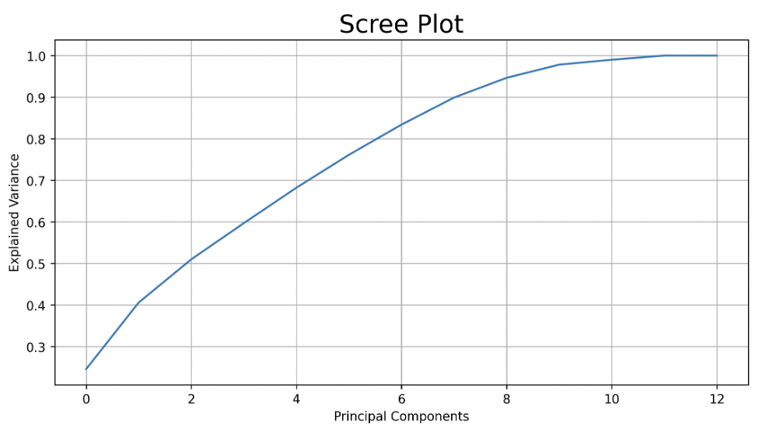
PCA

Slide 15
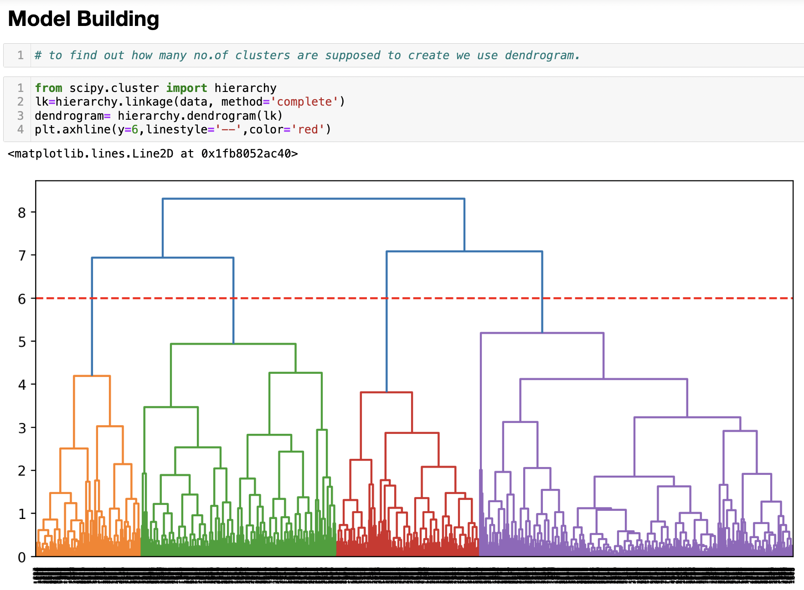
Generating a dendrogram helps in understanding the structure and relationships within the data and to choose the appropriate number of clusters

Slide 16
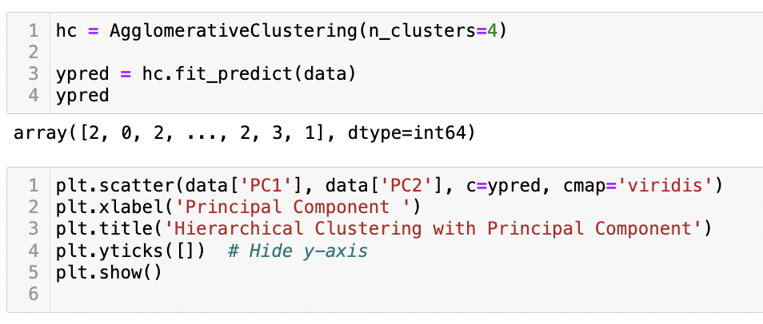
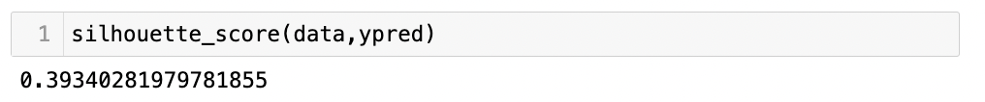
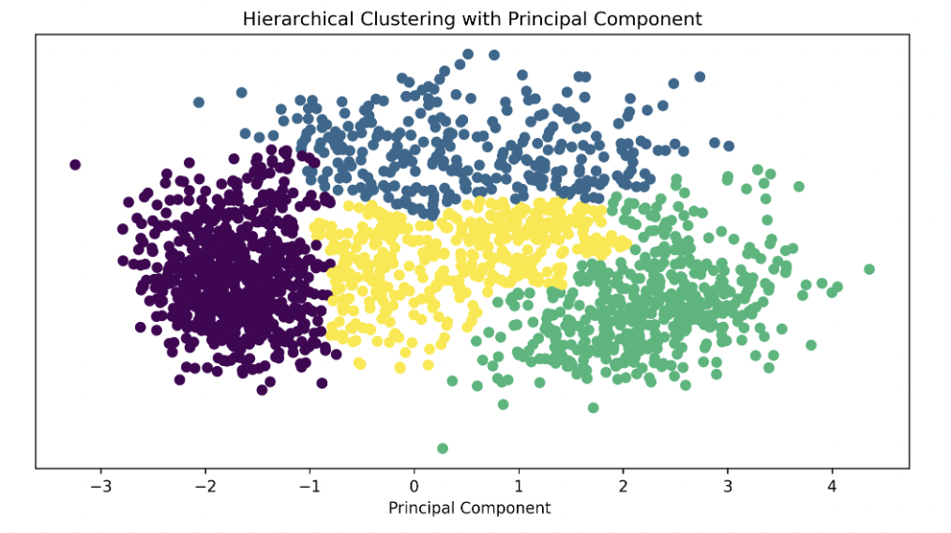
Performing hierarchical clustering on the data, visualizing the clusters in a scatter plot of the first two principal components.

Slide 17
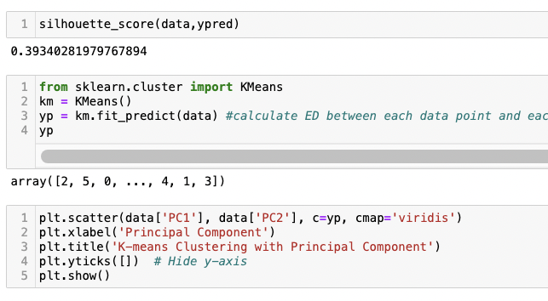
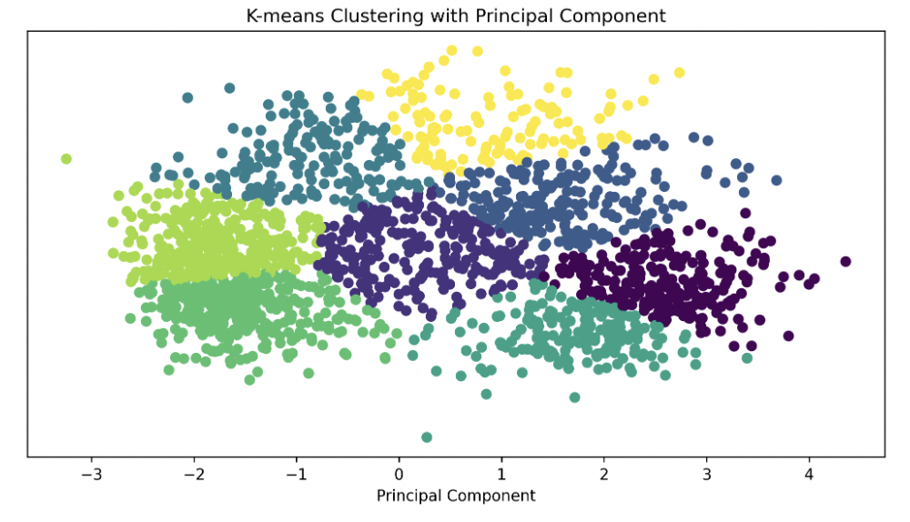
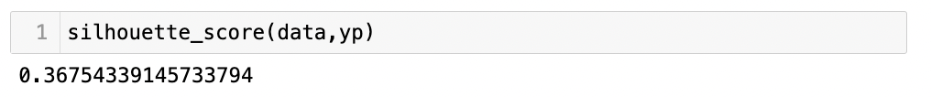
Performing K-means clustering on the data, visualizing the clusters in a scatter plot of the first two principal components.
Getting an accuracy of 36%

Slide 18
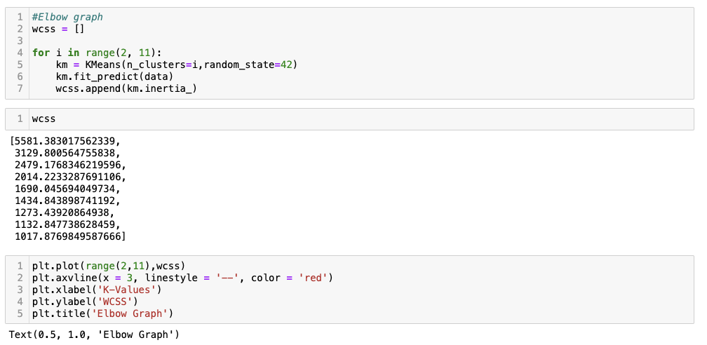
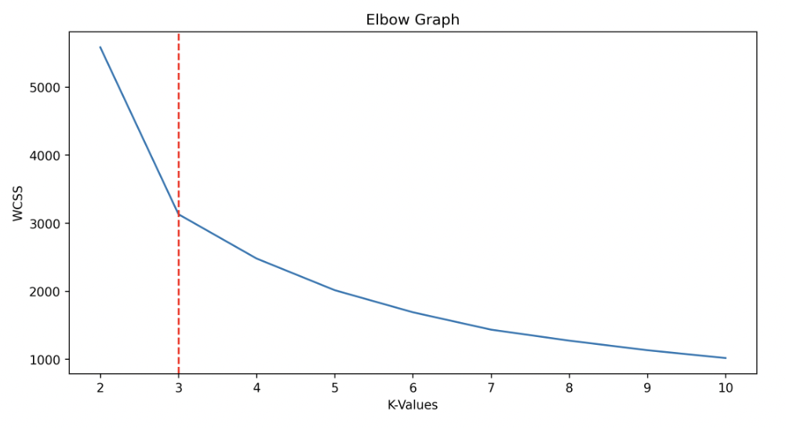
Using the Elbow method to determine the optimal number of clusters. The Elbow Graph visualizes the WCSS for different numbers of clusters, helping to identify the point where adding more clusters doesn't significantly improve the clustering performance.

Slide 19
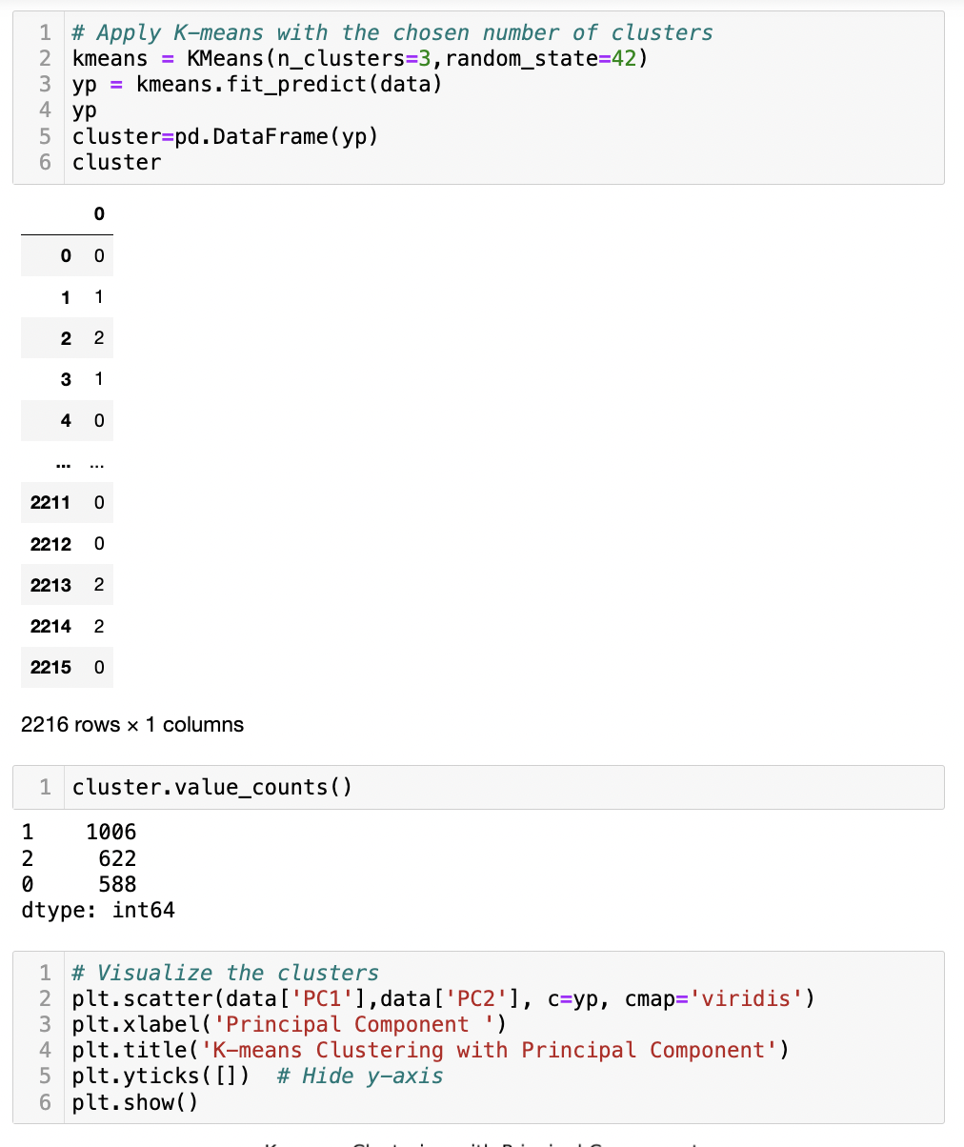
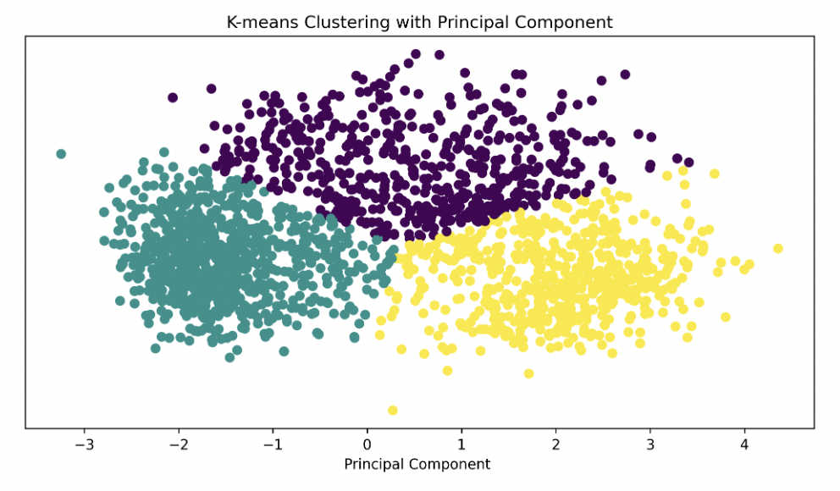
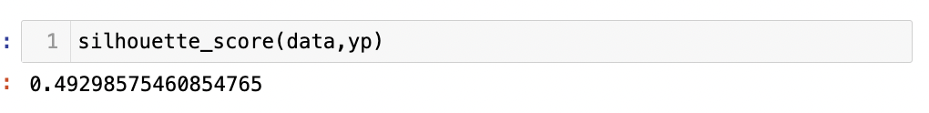
Trying K-Means clustering again with the number of clusters chosen by the Elbow method.
Getting an increased accuracy of 49%

Slide 20
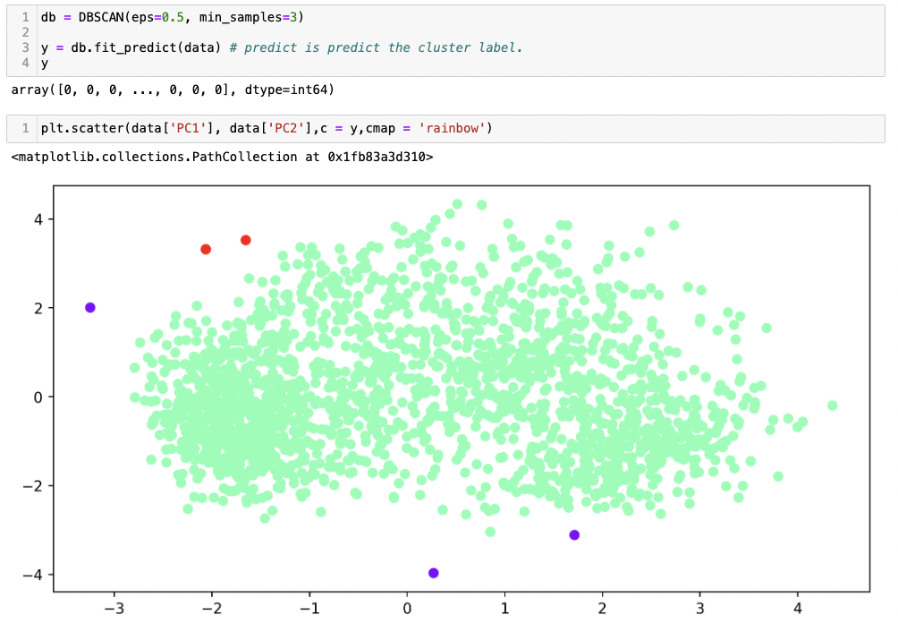
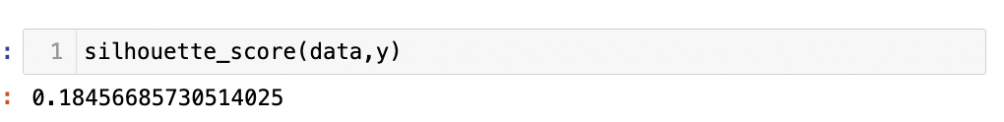
Getting an accuracy of 18%
Performing DBSCAN algorithm on the data to identify clusters of varying shapes and sizes in a dataset and for detecting outliers (noise points).

Slide 21
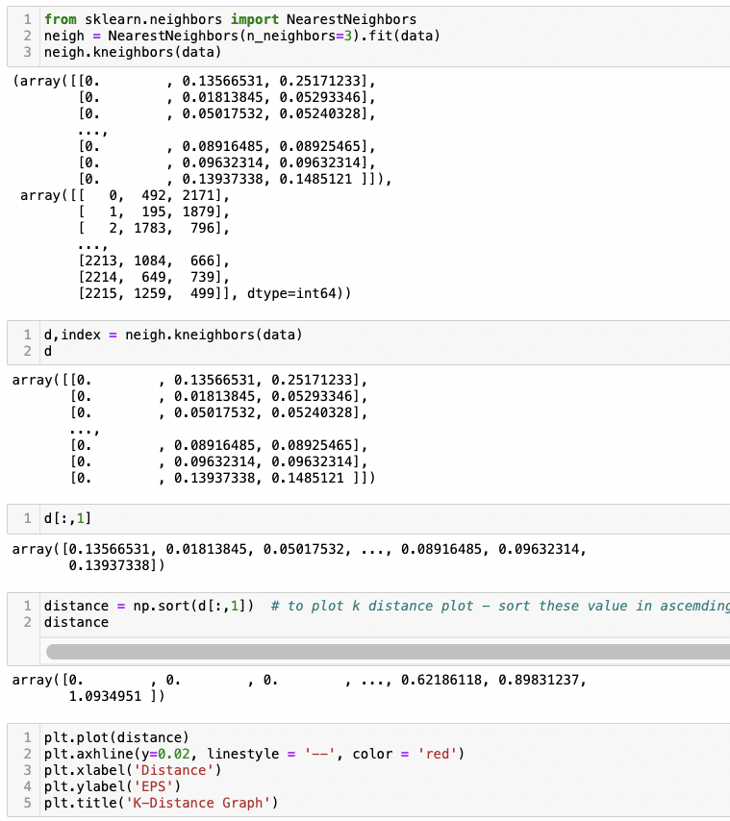
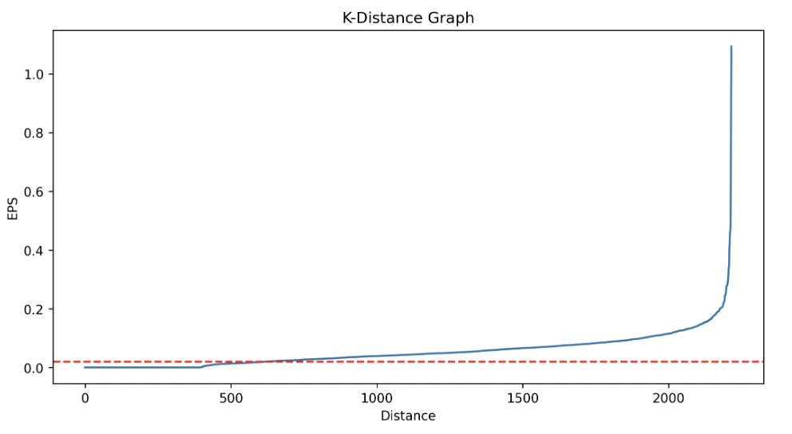
Using the Nearest Neighbours algorithm to find and analyse the distances to the second nearest neighbours for each data point in the dataset. The K-Distance graph, which plots these distances in ascending order, is useful for identifying a suitable epsilon value for clustering algorithms and choosing a natural clustering boundary.

Slide 22
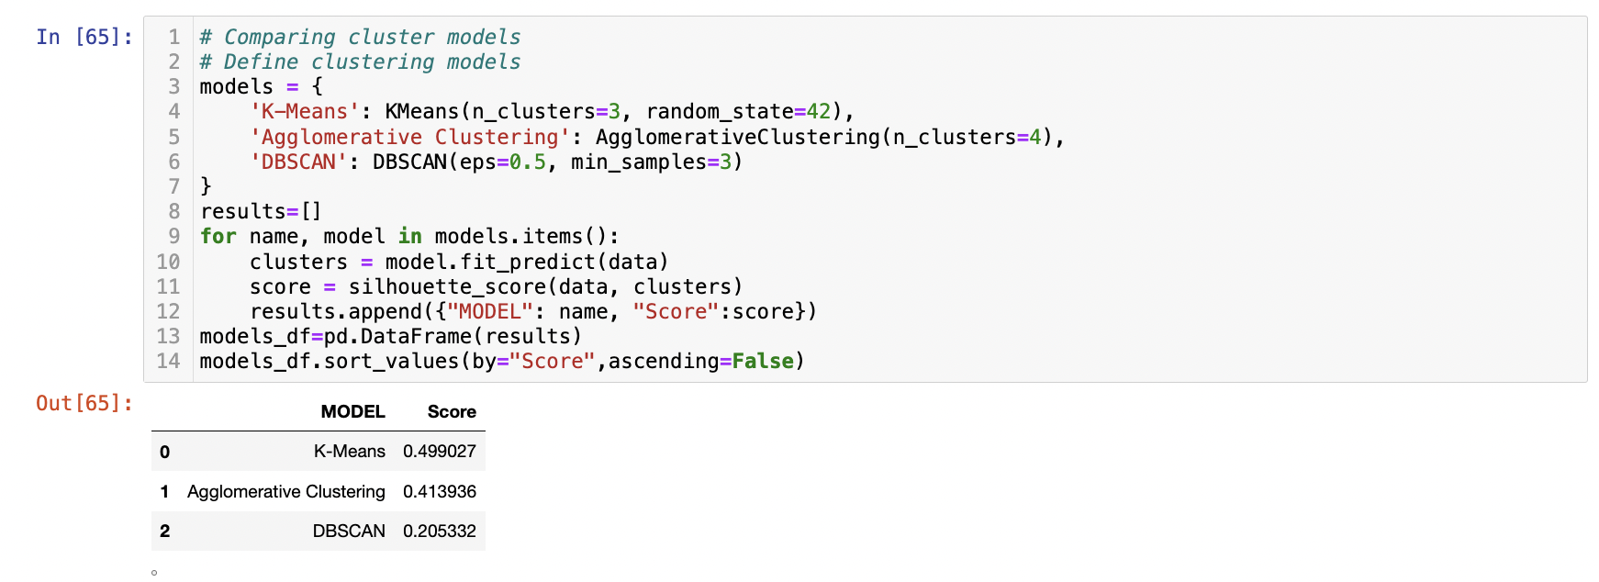
Comparing Clustering Models
The highest accuracy is K-Means with 49%

Slide 23
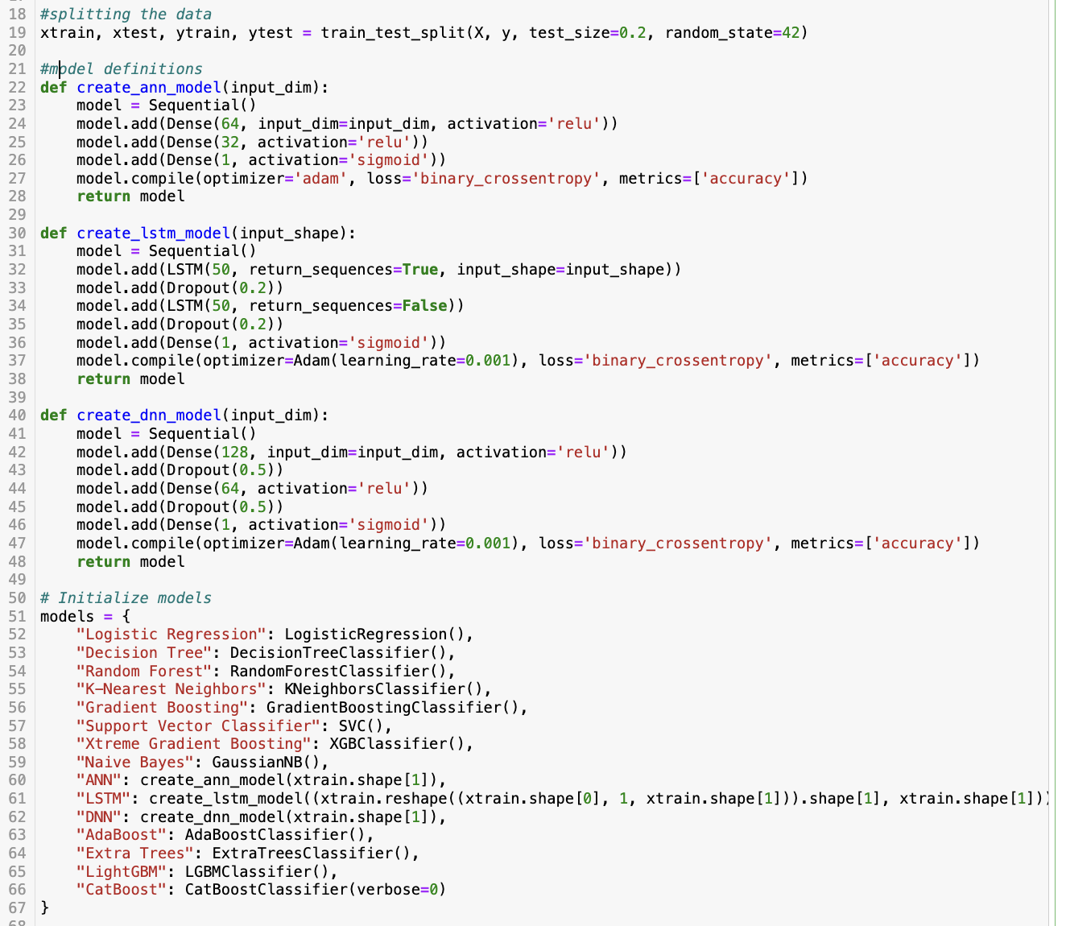
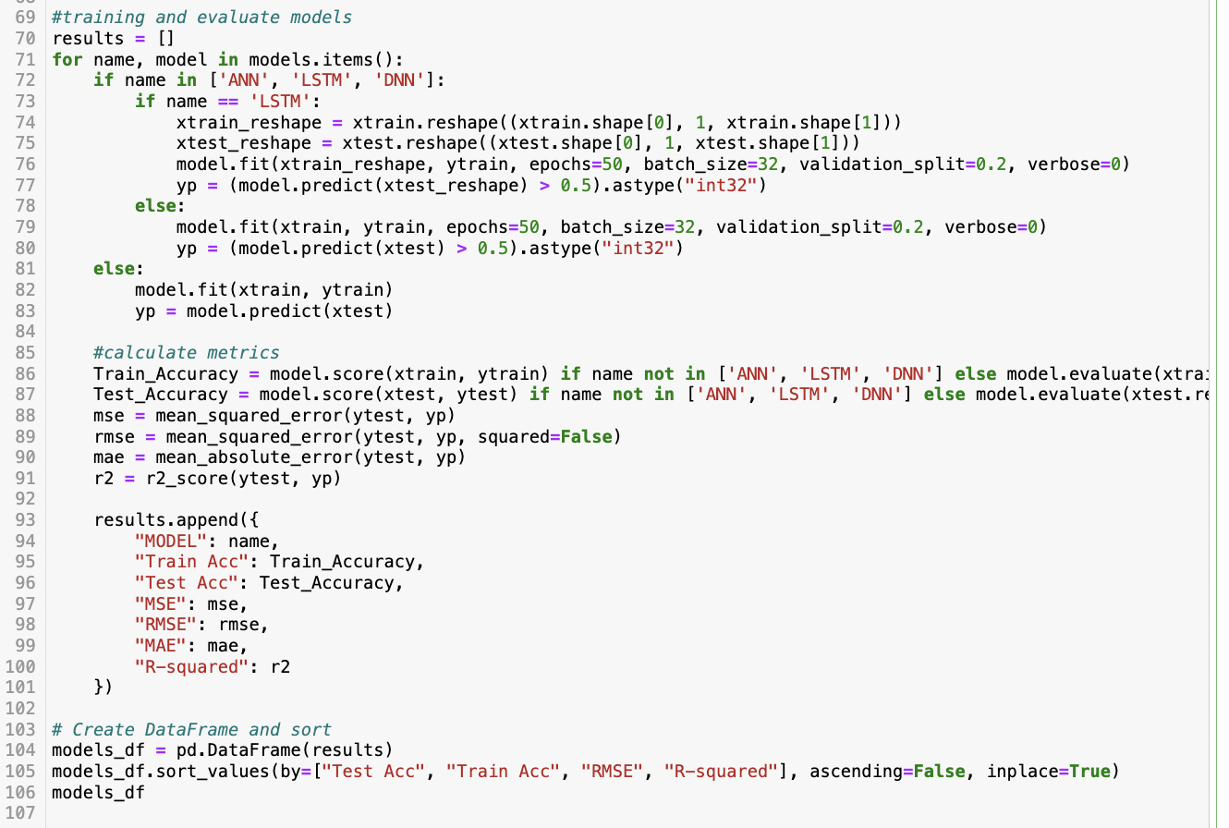
Classification Model Comparison Code
Defining, training and testing models to generate a table comparing their accuracies

Slide 24
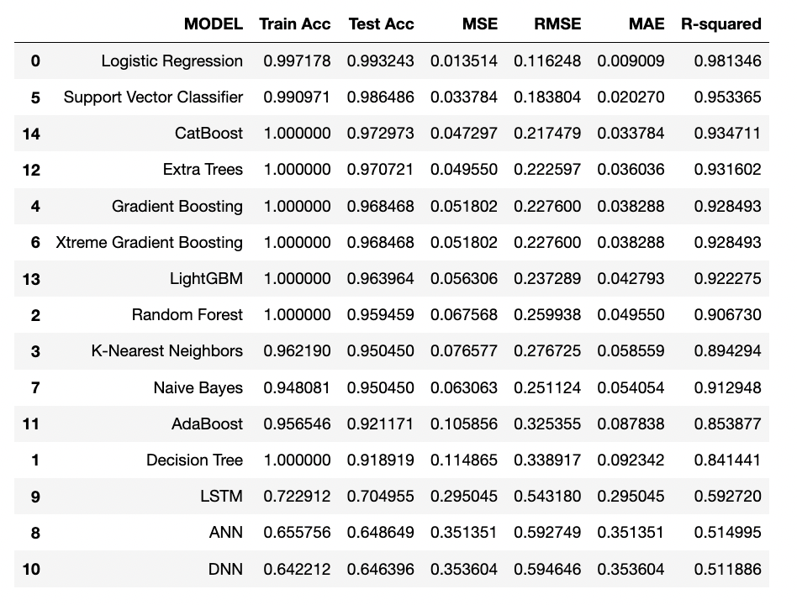
Model Classification Table
The highest accuracy we see is Support Vector Classifier so we will use this model for deployment.

Slide 25
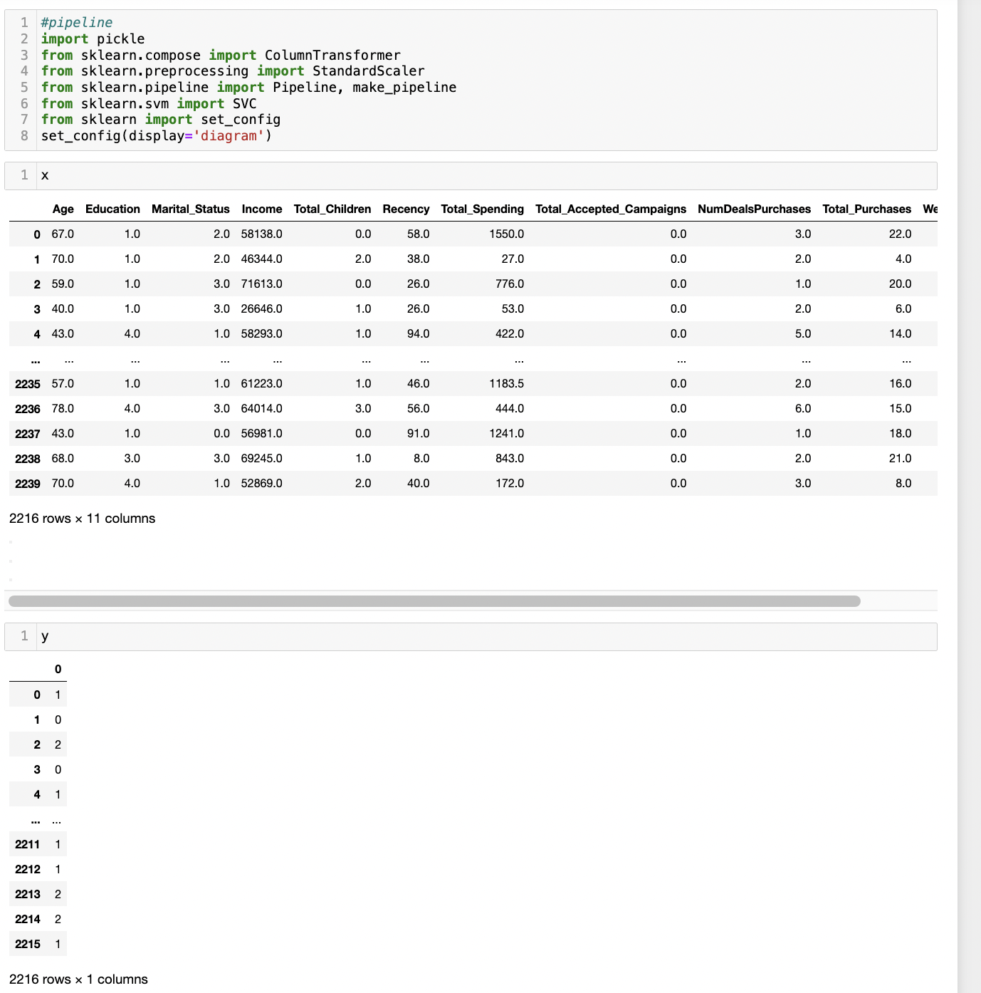
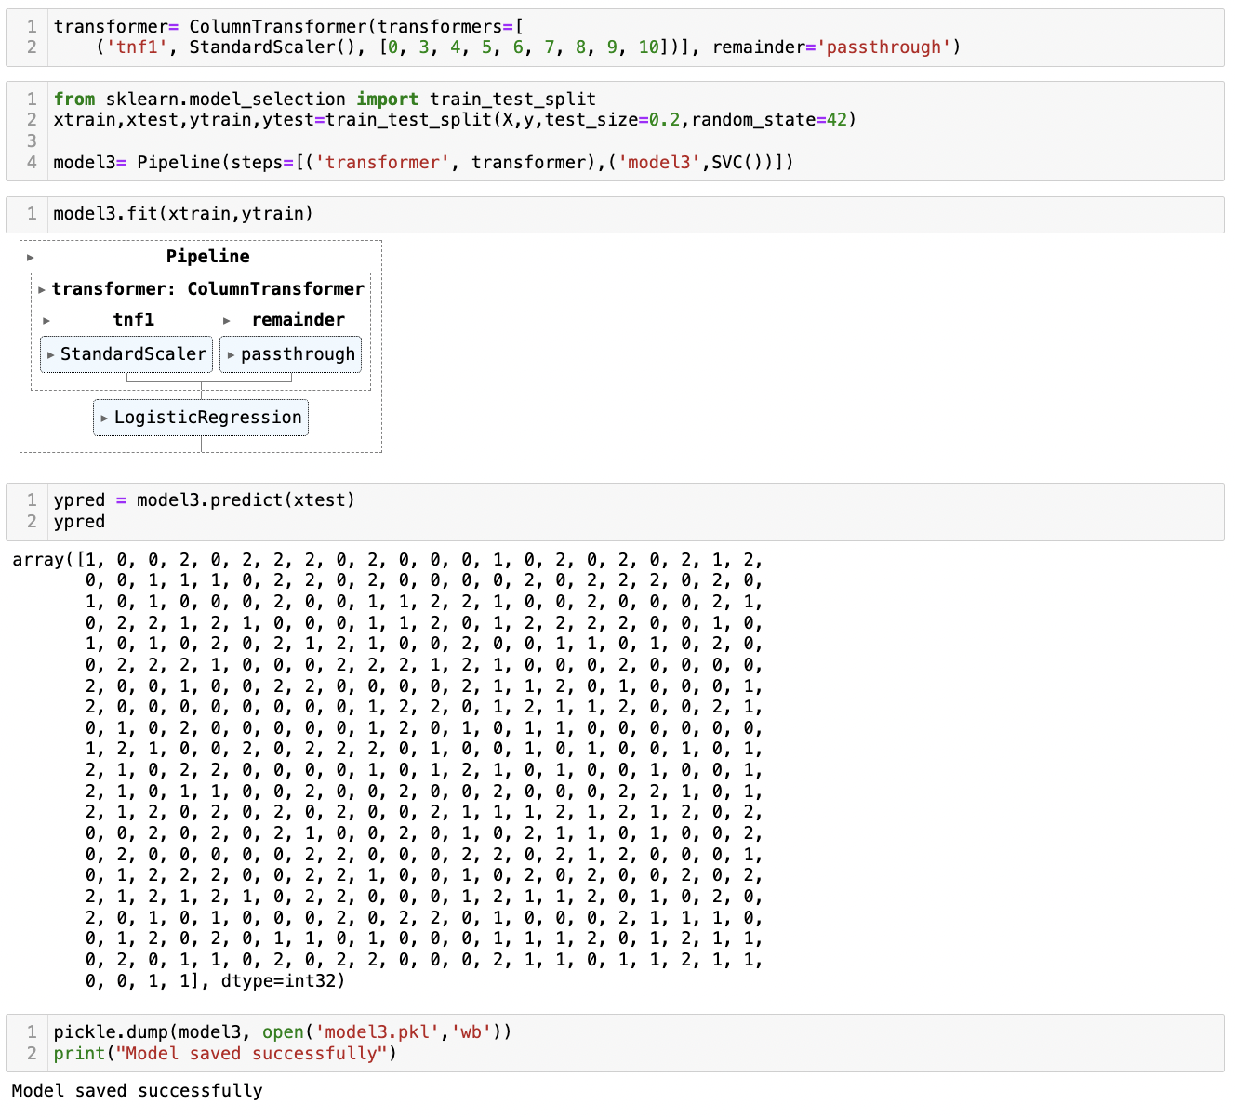
Creating model for Deployment

Slide 26
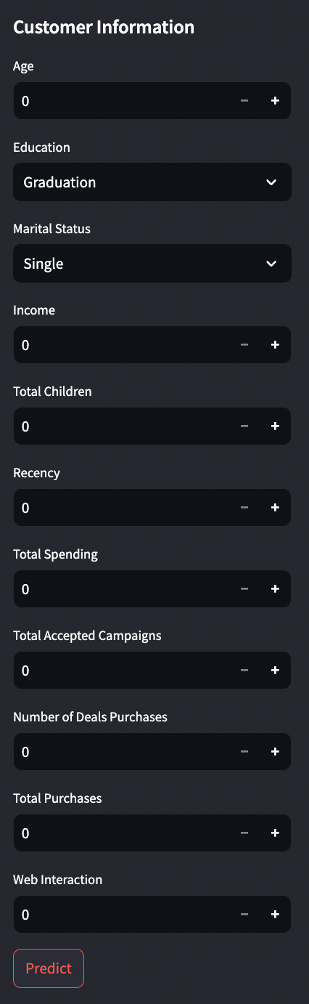
User Interface Inputs
Created an interface to put in the required customer information. The model will predict a cluster based on these inputs.

Slide 27
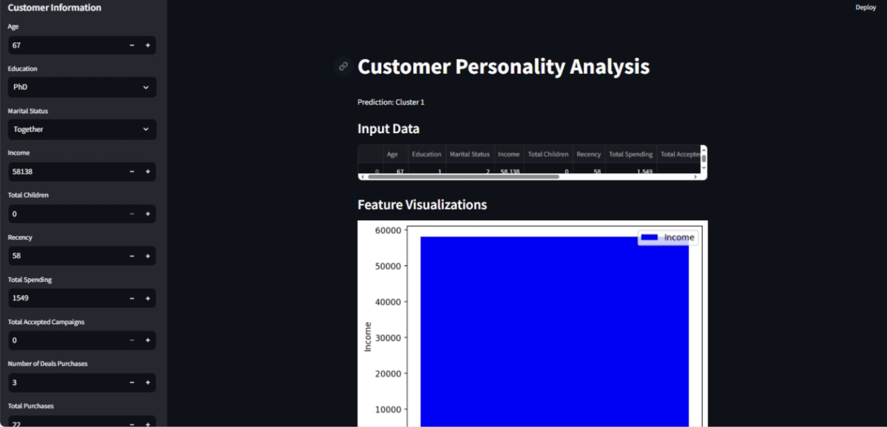
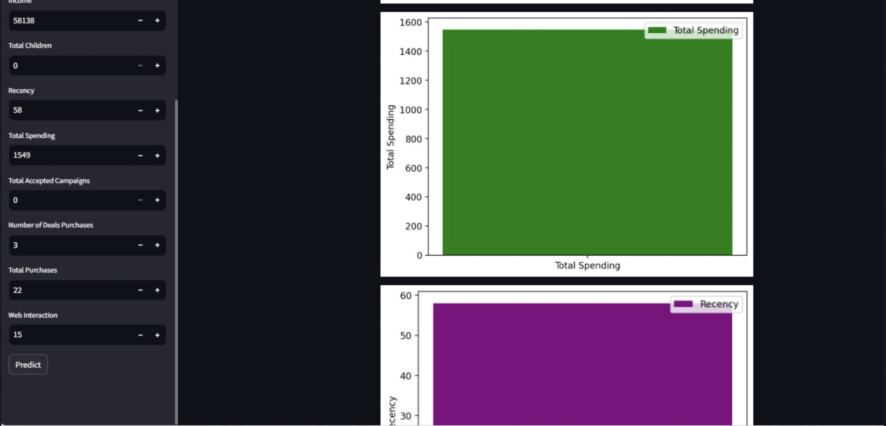
Model Prediction

Slide 28
Challenges
Making sense of the vast dataset and choosing actionable features while discarding useless ones
There were a lot of outliers in certain columns such as ‘Income’ and ‘Age’
Determining the number of clusters which provides the best accuracy while clustering
Testing various classification algorithms and comparing them to find the best-performing model and addressing the version compatibility issues that arise from trying to run so many algorithms
Making sure the model performs efficiently and accurately once deployed.

Slide 29
Solutions
Visualizing the data with the help of graphs to understand it on a deeper level and choose which features are needed
We removed outliers with the help of boxplots to clean the data
We used the Elbow graph method to determine the ideal number of clusters for the best accuracy
We updated all the libraries and made sure the versions are compatible to let the model run seamlessly
We tested the model after deployment to ensure that we were fixing every issue we found

Slide 30

Team 2
Sakshi Nimje
Aditi Girish Kallanagoudar
Abdul Aamir Khan

